Slide 1
Movie Ticketing System
Submitted To
Moumita Kabir
Submitted By
Name: MD Armanur Rakib
ID: 192014032

Slide 2
Introduction
Movie Ticketing System Database provide complete
Analyse data in a variety of ways.
Admin can easily can gather information .
Improve the quality and consistency of information

Slide 3
Objective:
The main objective of the Movie Ticket Booking System is to manage the details of Movies, Booking, Hall,Customer, Shows. It manages all the information about Seats, Movie, Shows. The project is totally built at administrative end and thus only the administrator is guaranteed the access.

Slide 4
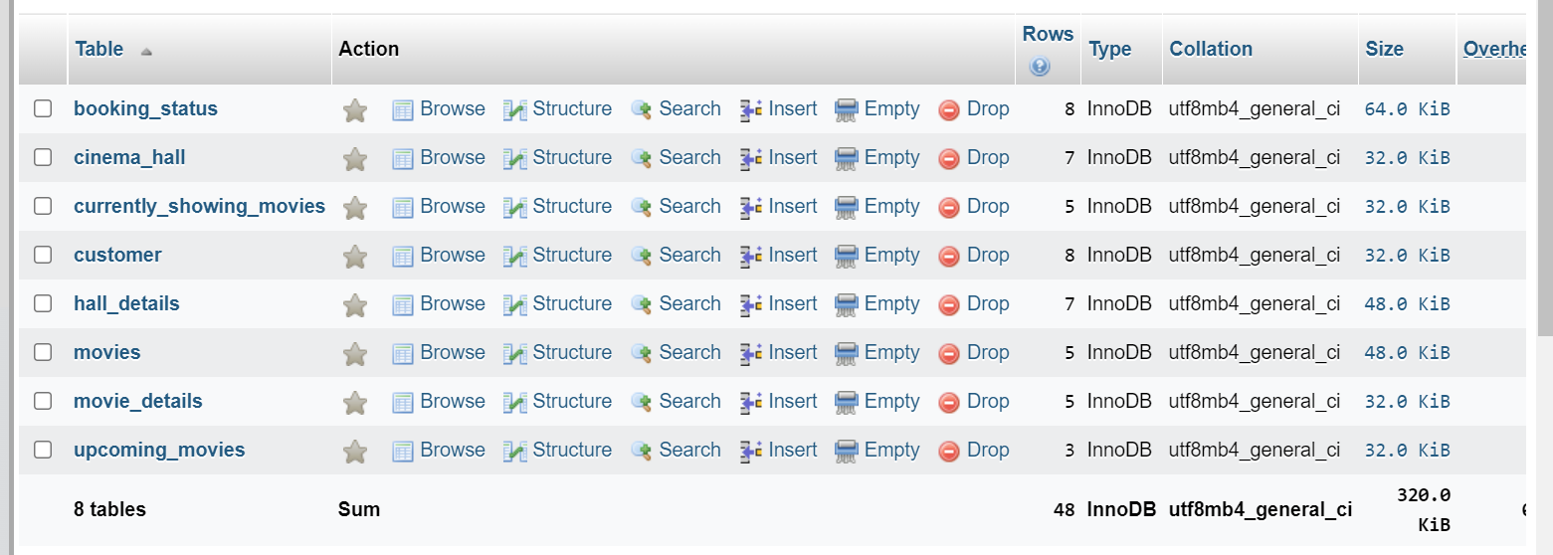
Movie Ticketing System have Eight Tables

Slide 5
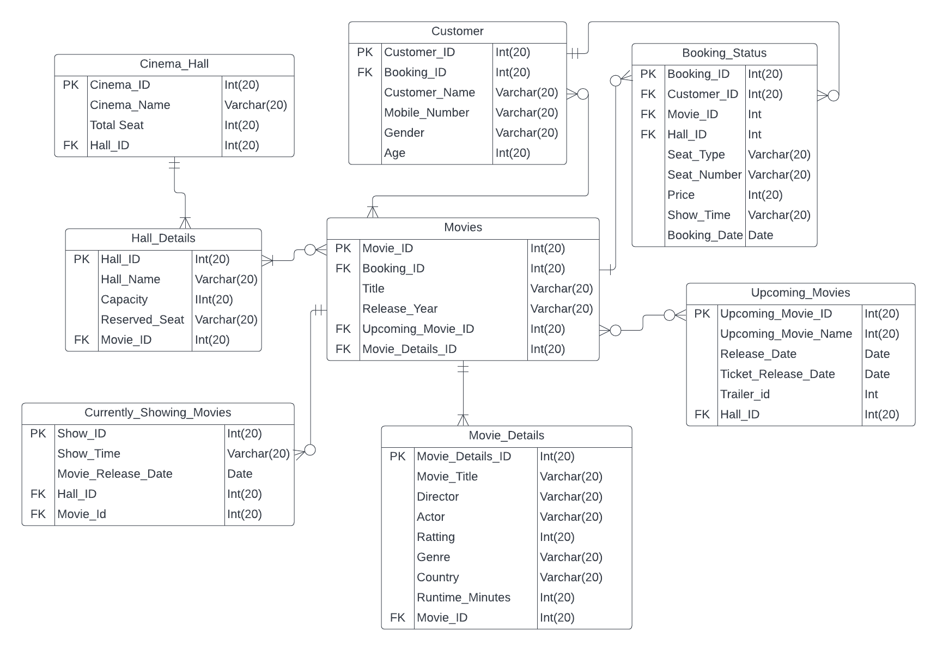
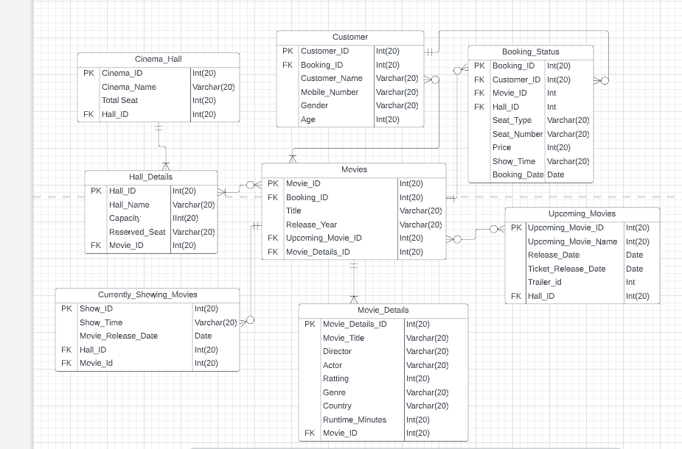
ER DIAGRAM

Slide 6
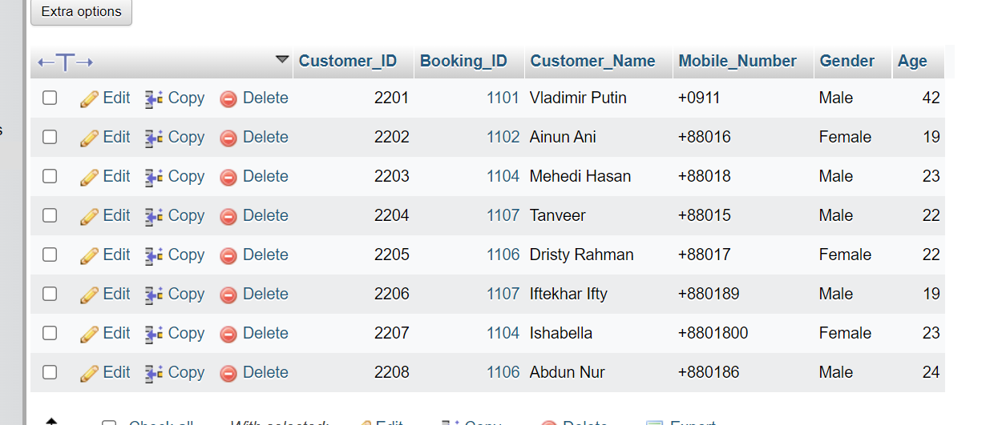
TABLE: BOOKING_Status

Slide 7
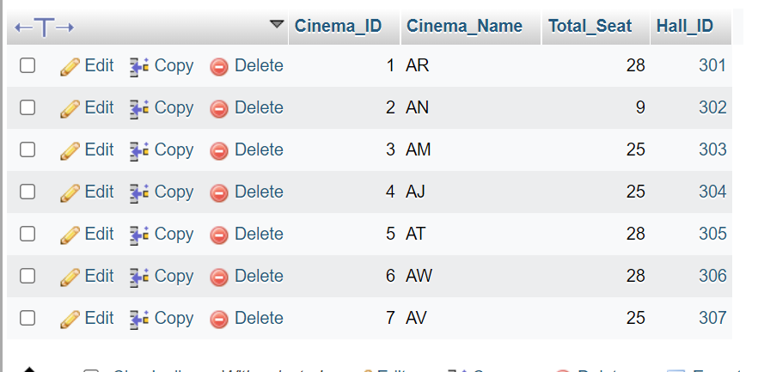
TABLE:CINEMA_Hall

Slide 8
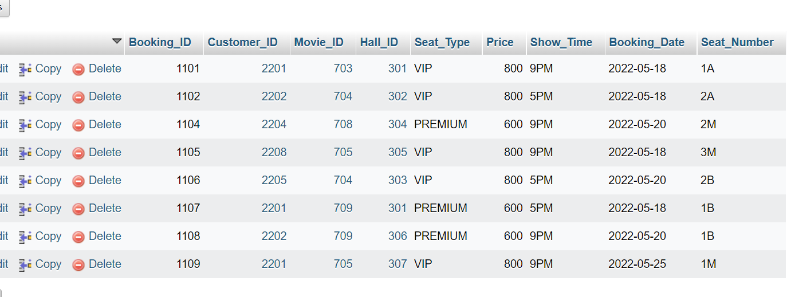
TABLE:Booking_Status

Slide 9
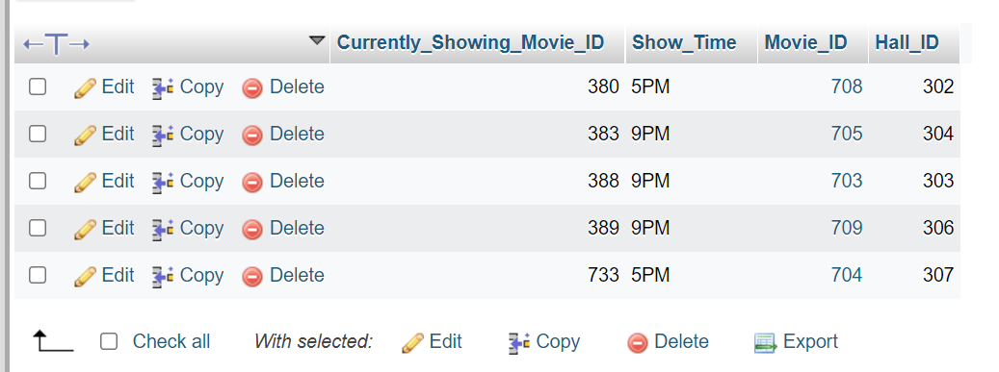
TABLE:Currently_Showing_Movies

Slide 10
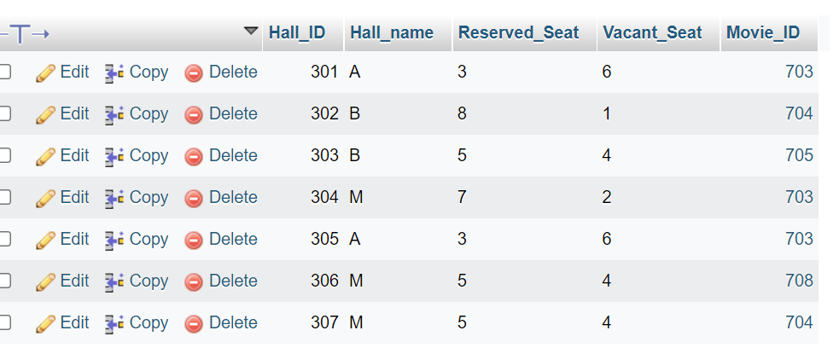
TABLE: HALL_Details

Slide 11
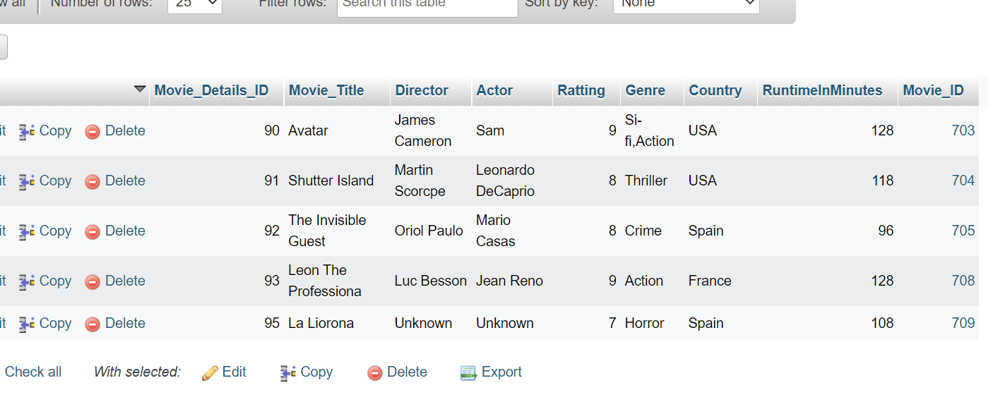
TABLE:Movie_Details

Slide 12
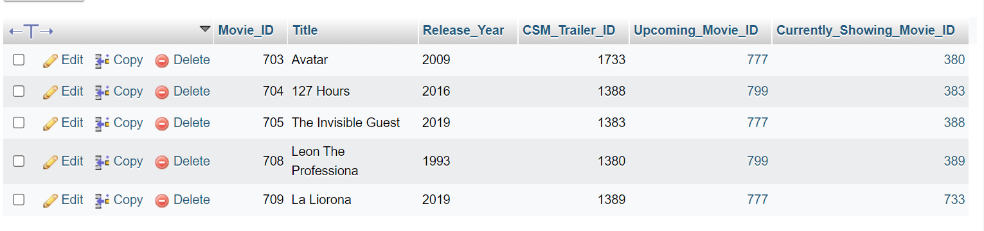
TABLE:Movies

Slide 13
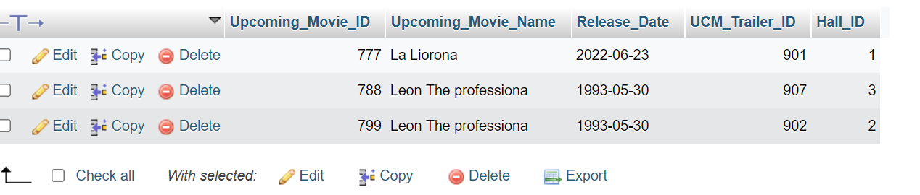
TABLE: Upcoming_Movies

Slide 14
THANK YOU

